Slide 1
Average Values in a Canonical Ensemble
We have developed the tools that permit us to calculate the average value of different physical quantities for a canonical ensemble of identical systems. In general, if the systems in an ensemble are distributed over their accessible states in accordance with the distribution p(ε_{i}), the average value of some quantity x (ε_{i}) can be found as:
$$\bar{x}=\left\langle x\left(ε_{i}\right)\right\rangle =\sum_{i}{x_{i}\left(ε_{i}\right)p\left(ε_{i}\right)}$$
In particular, for a
canonical ensemble:
Let’s apply this result to the average (mean) energy of the systems in a canonical ensemble (the average of the energies of the visited microstates according to the frequency of visits):
$$\left\langle E\right\rangle =\sum_{i}{ε_{i}p\left(ε_{i}\right)}=\sum_{i}{ε_{i}\frac{1}{Z}\exp\left(−βε_{i}\right)}=\frac{1}{Z}\sum_{i}{ε_{i}\exp\left(−βε_{i}\right)}$$
The total energy U_{tot} of N identical systems is:
$$−\frac{∂Z}{∂β}$$
As$Z=\sum_{i}{e^{−βε_{i}}}⇒\frac{∂Z}{∂β}=−{\sum_{i}{ε_{i}}e^{−βε_{i}}}_{}$
Another useful representation for the average energy
Therefore, if we know Z = Z (T,V,N), we know the average energy!

Slide 2
Standard Deviation
On the average, how individual values deviate from mean value
Deviation = $x_{i}−\overline{x}=∆x_{i}$
$$⇒ \left\langle dev\right\rangle =\overline{x_{i}−\overline{x}}=0$$
Always true
To avoid that, we have root-mean square of the deviation, called Standard Deviation, $σ$
(Square, then take the average and then take square root)
$$σ=±\sqrt{\overline{x^{2}}−{\overline{x}}^{2}}$$
For E, we have
$$\left\langle E\right\rangle =−\frac{1}{Z}\frac{∂Z}{∂β}=−\frac{∂}{∂β}\ln{Z}$$
$$⇒σ_{E}=k_{B}T\sqrt{\frac{C}{k_{B}}}$$
Where $C=\frac{∂\overline{E}}{∂T}$
Part of your Assignment

Slide 3
Paramagnetism
Find the total magnetization of a sample
Find the partition function for a single dipole (ideal two-state paramagnet);
Find the probability of state the dipole in
the “up” state;
the “down” state;
Check do these probabilities add up to 1.
Find the average energy of the dipole;
Find the total energy for a sample of N dipoles;
Find the average energy of the sample;
Find the average value of the dipole’s magnetic moment along the direction of B;
Find the total magnetization of the sample.

Slide 4
Paramagnetism
2-state ➔ only two possible energy state : with spin either up or down
Under applied magnetic field B, the energy of a dipole of dipole moment $μ$
$$E_{↑}=−μB$$
$$E_{↓}=μB$$
The partition function, $Z=\sum_{i}{e^{−βE_{i}}}$
$$Z=e^{βμB}+e^{−βμB}=2\cosh{(βμB)}$$
The probability for being in state up $p_{↑}=\frac{1}{Z}e^{−βE_{↑}}=\frac{e^{βμB}}{2\cosh{(βμB)}}$
And $p_{↓}=\frac{1}{Z}e^{−βE_{↓}}=\frac{e^{−βμB}}{2\cosh{(βμB)}}$
$$\overline{E}=\sum_{i}{p_{i}E_{i}}$$
➔ $\overline{E}=p_{↑}E_{↑}+p_{↓}E_{↓}$
$=\frac{−μBe^{βμB}}{2\cosh{(βμB)}}+$ $\frac{μBe^{−βμB}}{2\cosh{(βμB)}}$
$$=−μB\frac{\sinh{(βμB)}}{\cosh{(βμB)}}$$
OR $\overline{E}=−\frac{1}{Z}\frac{∂Z}{∂β}$
gives same result
$$\overline{E}=−μB\tanh{(βμB)}$$
For N dipoles
$$U=N\overline{E}=−NμB\tanh{(βμB)}$$
Same as we had in Ch 3

Slide 5
The Magnetization, M
We need average magnetic moment of the dipole, in the direction of B
$$\overline{μ}=\sum_{i}{μ_{i}p_{i}=μp_{↑}+(−μ)p_{↓}}$$
$$=μ\left(p_{↑}−p_{↓}\right)$$
$$=μ\left[\frac{e^{βμB}−e^{−βμB}}{2\cosh{(βμB)}}\right]$$
$$=μ\tanh{(βμB)}$$
Therefore, for N dipoles
$$M=Nμ\tanh{(βμB)}$$
Same as we got in Ch 3

Slide 6
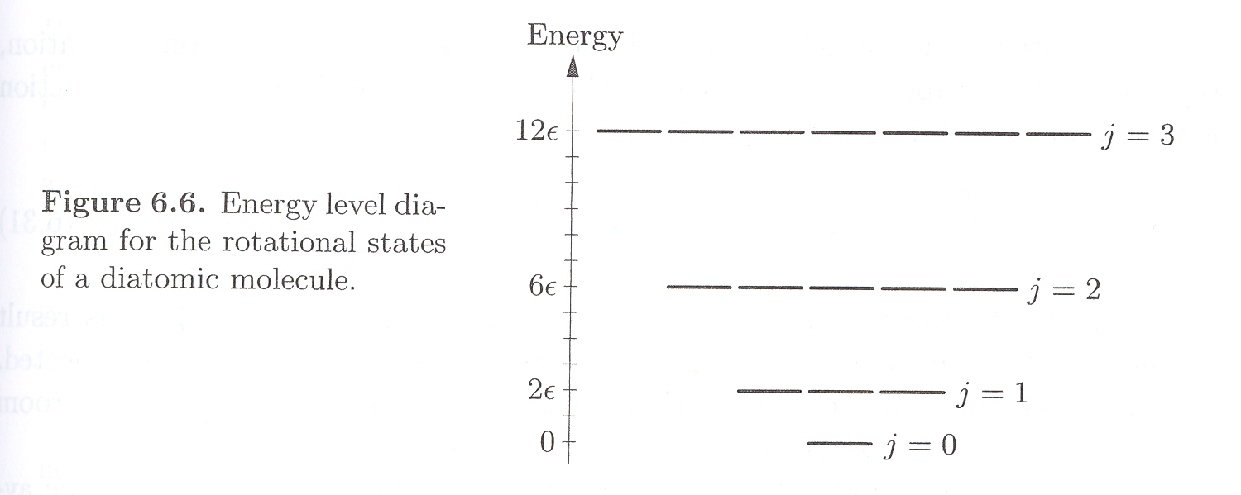
Rotational Energies of Diatomic Molecules
The molecule (CO or HCl) is isolated as in a low-density gas.
Rotational energies are quantized:
E(j) = j(j + 1)ε
J = 0, 1, 2, …
Energy is a constant inversely proportional to the molecule’s momentum of inertia.
The number of degenerate states for level j is
2 j + 1

Slide 7
Rotational Energies of Diatomic Molecules
We can write partition function, Z for rotational energy
$$Z_{rot}=\sum_{j=0}^{∞}{\left(2j+1\right)e^{{−E}_{j}β}}$$
$$=\sum_{j=0}^{∞}{\left(2j+1\right)e^{−j(j+1)εβ}}$$
$$≈\int_{0}^{∞}{\left(2j+1\right)e^{−j(j+1)εβ}}dj$$
$$OR\int_{0}^{∞}{\left(2j+1\right)e^{−j(j+1)ε/{(k}_{B}T)}}dj$$
To evaluate this integral substation $j\left(j+1\right)\frac{ε}{k_{B}T}=x$
When $j→0, x→0$
When $j→∞, x→∞$
$$Z_{rot}=\frac{k_{B}T}{ε} or \frac{1}{βε}$$
As $\overline{E}=−\frac{1}{Z}\frac{∂Z}{∂β}$
$$\overline{E_{rot}}≈\frac{1}{β}=k_{B}T$$
For $k_{B}T≫ε$

Slide 8
Helmholtz Free Energy, F
The Boltzmann statistic is applicable where the system is in good thermal contact with the environment
(T is fixed and we kept N as constant, and ignore any changes in V )
Canonical Ensemble
In this situation, F is natural thermodynamic potential
We know, $F=U−TS$
$$⇒ dF=dU−TdS−SdT$$
$$⇒ dF=\left(TdS−PdV+μdN\right)−TdS−SdT$$
$$dF=−SdT−PdV+μdN$$
$$S=−{\left(\frac{∂F}{∂T}\right)}_{V, N}$$
$$P=−{\left(\frac{∂F}{∂V}\right)}_{T, N}$$
$$μ={\left(\frac{∂F}{∂N}\right)}_{T, V}$$
Here U = E
⇒ $\overline{F}=\overline{E}−\overline{T}\overline{S}$
We also know,
$\overline{E}=−\frac{1}{Z}\frac{∂Z}{∂β}=−\frac{∂}{∂β}\left(\ln{Z}\right)$
$$S=−{\left(\frac{∂F}{∂T}\right)}_{V, N}=−{\left(\frac{∂F}{∂β}\right)}_{V, N}\frac{∂β}{∂T}$$
Therefore,
We have $\frac{∂β}{∂T}=\frac{∂}{∂T}\left(\frac{1}{k_{B}T}\right)$
$=−\frac{1}{k_{B}T^{2}}=−k_{B}β^{2}$
$\overline{S}=k_{B}β^{2}$ ${\left(\frac{∂F}{∂β}\right)}_{V, N}$

Slide 9
As $\overline{F}=\overline{E}−\overline{T}\overline{S}$
$\overline{E}=−\frac{∂}{∂β}\left(\ln{Z}\right)$
➔ $\overline{F}=−\frac{∂}{∂β}\left(\ln{Z}\right)−T$ $k_{B}β^{2}$ ${\left(\frac{∂\overline{F}}{∂β}\right)}_{V, N}$
$\overline{S}=k_{B}β^{2}$ ${\left(\frac{∂F}{∂β}\right)}_{V, N}$
➔ $\overline{F}=−\frac{∂}{∂β}\left(\ln{Z}\right)−β$ ${\left(\frac{∂\overline{F}}{∂β}\right)}_{V, N}$
➔ $\overline{F}+β {\left(\frac{∂\overline{F}}{∂β}\right)}_{V, N}=−\frac{∂}{∂β}\left(\ln{Z}\right)$
$\overline{F}+β {\left(\frac{∂\overline{F}}{∂β}\right)}_{V, N}=−\frac{∂}{∂β}\left(\ln{Z}\right)$
$${⇒ \left(\frac{∂(\overline{F}β)}{∂β}\right)}_{V, N}=−\frac{∂}{∂β}\left(\ln{Z}\right)$$
➔ $\overline{F}β=−lnZ$
$$\overline{F}=−\frac{1}{β}lnZ$$
This is statistical definition of
Helmholtz Free Energy
Similarly, we get Entropy, S
$$S=−k_{B}\sum_{s}{p_{s}lnp_{s}}$$
P: 6.43 part of Assignment

Slide 10
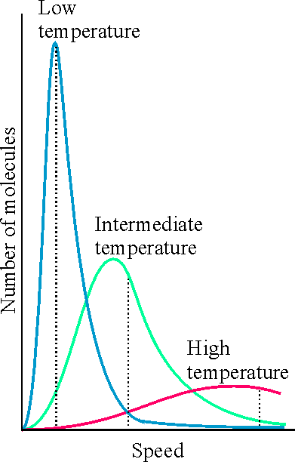
The Maxwell Speed Distribution
Reading Assignment
Maxwell
distribution
P(v)
energy distribution, N – the total # of particles
speed distribution
v
distribution for the projection of velocity, v_{x}

Slide 11
The Characteristic Values of Speed
Reading Assignment
Because Maxwell distribution is skewed (not symmetric in v), the root mean square speed is not equal to the most probable speed.
P(v)
The root-mean-square speed is proportional to the square root of the average energy:
v
The most probable speed:
The average speed:

Slide 12
Composite System
The partition function will be $Z_{Total}=\sum_{s}{e^{−βE_{s, Total}}}$
A system of several particles.
Let’s say we have 2 particles with energies, E₁ and E₂
The particles may have several states
$$Z_{Total}=\sum_{s}{e^{−β(E_{1s}+E_{2s})}}=\sum_{s}{e^{−βE_{1s}}∙e^{−βE_{2s}}}$$
For Distinguishable Particles (Non interacting)
Due to rotation, $Z_{rot}=\sum_{s}{e^{−βE_{s, rot}}}$
For high temp. $k_{B}T≫E \left(or β≪ε\right)$
$$⇒ Z_{rot}\sim \frac{ε}{k_{B}T}$$
$$Z_{Total}=\sum_{s1}{e^{−β(E_{1, s1})}}\sum_{s2}{e^{−βE_{2, s2}}}=Z_{1} Z_{2}$$
For Indistinguishable Particles (non-interacting)
In this case, the sate of particle 1 in state & particle 2 in state B will be same as particle 1 in state B and 2 in state A.
$$Z_{Total}=\frac{1}{2}Z_{1} Z_{2}$$
For 3 particles, $Z_{Total}=\frac{1}{2}\frac{1}{3}Z_{1} Z_{2}Z_{3}$
For N particles, $Z_{Total}=\frac{1}{N!}Z_{1} Z_{2}Z_{3}⋯Z_{N}$
Since particles are indistinguishable,
$$Z_{1}=Z_{2}=⋯=Z_{N}$$
$$Z_{Total}=\frac{1}{N!}Z_{1}^{N}$$
It is important to distinguish state of an individual particle from state of the entire system, we can call single particle state and state of system
Due to rotation, in case this case, for high temp. $k_{B}T≫E \left(or β≪ε\right)⇒ Z_{rot}\sim \frac{ε}{{2k}_{B}T}$

Slide 13
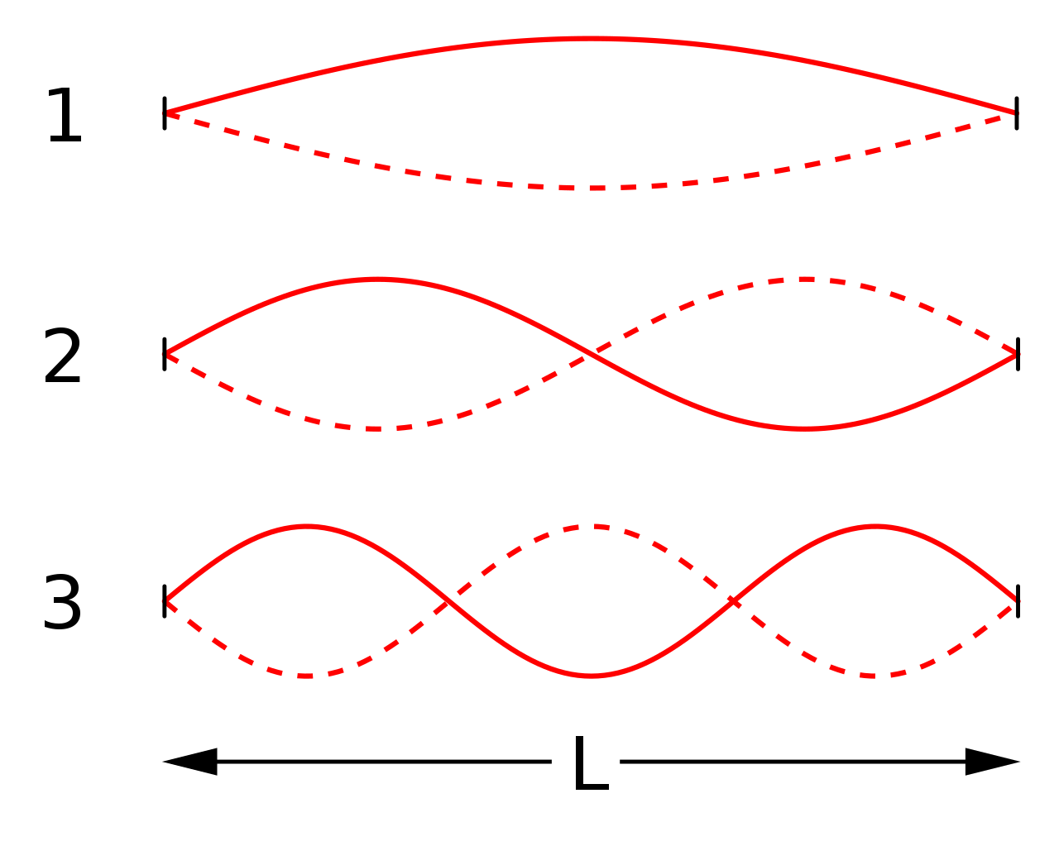
Ideal gas
Particles are identical – indistinguishable
$$Z_{Total}=\frac{1}{N!}Z_{1}^{N}$$
$$Z_{1}=\sum_{s}{e^{−\frac{E_{s}}{k_{B}T}}}$$
While $E=E_{Tr}+E_{int}$
Translational & Internal
$Z_{1}=\sum_{s_{Tr}}{e^{−\frac{E_{Tr, s}}{k_{B}T}}}$ $\sum_{s_{Tr}}{e^{−\frac{E_{Int, s}}{k_{B}T}}}$
Rotational and vibrational
$$Z_{Tr}=\sum_{s_{Tr}}{e^{−\frac{E_{Tr, s}}{k_{B}T}}}$$
And $Z_{Int}=\sum_{s_{Tr}}{e^{−\frac{E_{Int, s}}{k_{B}T}}}$
Therefore, $Z=Z_{Tr} Z_{Int}$
Translational Energy
We need to find $E_{Tr}$
A particle can have any energy state, let’s say $E_{n}$
In 1-dimension
$$E_{n}=\frac{p^{2}}{2m}$$
The momentum, $p=\frac{h}{λ_{n}}$
$$λ_{1}=\frac{2L}{1}$$
$$E_{n}=\left(\frac{h^{2}n^{2}}{L^{2}}\right)\frac{1}{8m}$$
$$λ_{2}=\frac{2L}{2}$$
➔ $Z_{Tr}=\sum_{n}{e^{−\frac{n^{2}h^{2}}{8mL^{2}k_{B}T}}}$
$$λ_{1}=\frac{2L}{3}$$
If L and T are not extremely small, energy levels can be extremely close to each other, and we can write
$$λ_{n}=\frac{2L}{n}$$
➔ $Z_{Tr}=\int_{0}^{∞}{e^{−\frac{n^{2}h^{2}}{8mL^{2}k_{B}T}}}dn$

Slide 14
$$Z_{Tr}=\int_{0}^{∞}{e^{−\frac{n^{2}h^{2}}{8mL^{2}k_{B}T}}}dn$$
➔ $Z_{Tr}=\sqrt{\left(\frac{8mL^{2}k_{B}T}{h^{2}}\right)}\int_{0}^{∞}{e^{−x^{2}}}dx$
$Z_{Tr}=$ $\sqrt{\left(\frac{8mL^{2}k_{B}T}{h^{2}}\right)}\frac{π}{2}$
$Z_{Tr}=$ $\sqrt{\left(\frac{8mk_{B}T}{h^{2}}\right)}\frac{π}{2}L$
$$l_{Q}=\frac{h}{\sqrt{2πmk_{B}T}}$$
Called
Quantum length
$$Z_{Tr}=\frac{L}{l_{Q}}$$
It is $\frac{λ_{d}}{\sqrt{π}}$ $λ_{d}=$de Broglie wavelength
In 3-dimension
$E_{Tr}=\frac{p_{x}^{2}}{2m}+\frac{p_{y}^{2}}{2m}$+ $\frac{p_{z}^{2}}{2m}$
$$Z_{Tr}=\frac{V}{V_{Q}}$$
The Quantum Volume, $V_{Q}=l_{Q}^{3}$
Therefore,
$Z_{1}=Z_{Tr} Z_{Int}$
$$V_{Q}={\left(\frac{h^{2}}{2πmk_{B}T}\right)}^{3/2}$$
$$=\frac{V}{V_{Q}}Z_{int}$$
For N particles, as $Z=\frac{Z_{1}^{N}}{N!}$
➔ $Z=\frac{1}{N!}{\left(\frac{V}{V_{Q}}Z_{int}\right)}^{N}$
For indistinguishable, non-interacting particles
(Ideal Gas)

Slide 15
Since $Z=\frac{1}{N!}{\left(\frac{V}{V_{Q}}Z_{int}\right)}^{N}$
We can write
$$lnZ=N\left[lnV+lnZ_{int}−lnV_{Q}\right]−lnN!$$
For large N
Stirling Approximation
$$lnN!≈NlnN−N$$
$$lnZ=N\left[lnV+lnZ_{int}−lnV_{Q}−lnN+1\right]$$
Once we have Z, we can calculate, energy, heat capacity, Helmholtz Free energy, etc.
Energy, $U=N\overline{E}$
$$U=−\frac{1}{Z}\frac{∂Z}{∂β}=−\frac{∂(lnZ)}{∂β}$$
➔ $U=U_{int}+\frac{3}{2}Nk_{B}T$
Heat Capacity, C
$$C=\frac{∂U}{∂T}=\frac{∂U_{int}}{∂T}+\frac{3}{2}Nk_{B}$$
Note:
$V_{Q}={\left(\frac{h^{2}}{2πmk_{B}T}\right)}^{3/2}⇒ \frac{1}{V_{Q}}\frac{∂V_{Q}}{∂β}=\frac{3}{2β}$
$β=\frac{1}{k_{B}T}$
$U_{int}=N\overline{E_{int}}$
$F_{int}=−Nk_{B}TlnZ_{int}$
Helmholtz Free Energy, F
$$F=−k_{B}TlnZ$$
➔ $F=−Nk_{B}T\left[ln\left(\frac{V}{V_{Q}N}\right)+1\right]+F_{int}$

Slide 16
We can also calculate, $P, S, and μ$
$$P=−{\left(\frac{∂F}{∂V}\right)}_{T, N}$$
$$⇒ P=\frac{Nk_{B}T}{N}$$
$$S=−{\left(\frac{∂F}{∂T}\right)}_{V, N}$$
$$⇒ S=Nk_{B}\left[ln\left(\frac{V}{NV_{Q}}\right)+\frac{5}{2}\right]+\frac{∂F_{int}}{∂T}$$
$$μ={\left(\frac{∂F}{∂N}\right)}_{T, V}$$
$$⇒ μ=k_{B}Tln\left(\frac{VZ_{int}}{NV_{Q}}\right)$$

Slide 17
Microcanonical ⇔ Canonical
Our description of the microcanonical and canonical ensembles was based on counting the number of accessible microstates. Let’s compare these two cases:
microcanonical ensemble
canonical ensemble
For an isolated system, the multiplicity Ω provides the number of accessible microstates. The constraint in calculating the states: U, V, N = const.
For a fixed U, the mean temperature T is specified, but T can fluctuate.
For a system in thermal contact with reservoir, the partition function Z provides the # of accessible microstates. The constraint: T, V, N = const.
For a fixed T, the mean energy U is specified, but U can fluctuate.
the probability of finding a system in one of the accessible states
the probability of finding a system in one of these states
$$S\left(U,V,N\right)=k_{B}\ln{Ω}$$
in equilibrium, S reaches a maximum
in equilibrium, F reaches a minimum

Slide 18
For the canonical ensemble, the role of Z is similar to that of the multiplicity Ω for the microcanonical ensemble. This equation gives the fundamental relation between statistical mechanics and thermodynamics for given values of T, V, and N; just as S = k_{B} ln Ω gives the fundamental relation between statistical mechanics and thermodynamics for given values of U, V, and N.

Slide 19
Chapter 6: Practice Problems
6.5, 6.6, 6.7, 6.10, 6.12, 6.15, 6.23, 6.24, 6.25, 6.42, 6.47, 6.48 and 6.50.
Assignment# 8
6.2, 6.14, 6.16, 6.18 and 6.20 (a, b, c, d only).
Due Friday, 4/15/2022
Assignment# 9
6.31, 6.43, 6.44, 6.45 and 6.49
and reading “Maxwell Velocity Distribution”, Page 242 – 246.
Due Friday, 4/22/2022

